Slide 1
Subnetting

Slide 2
Introduction
Subnetting is the foundation underlying the expansion of both Local Networks & the Internet in today’s world.
Subnetting has become essential knowledge for the Administrator of any network.
There are 2 fundamental reasons why subnetting has so much importance in today’s networking environment:

Slide 3
Introduction (Cont.)
The world is running out of available IP addresses. There just isn’t an unlimited number of IP addresses available & subnetting helps extend the existing addresses until either the next version of IP is rolled out or some other technology charges on the scene.

Slide 4
Introduction (Cont.)
Subnetting reduces the size of the routing tables stored in routers. Subnetting extends the existing IP address base & restructures the IP address. As a result, routers must have a way to extract from a IP address both the Network address & the Host address.

Slide 5
Introduction (Cont.)
There are only 3 usable IP address classes:
Class A
Class B
Class C
Class A networks have the highest number of available hosts.
Class C networks have the fewest number of hosts.

Slide 6
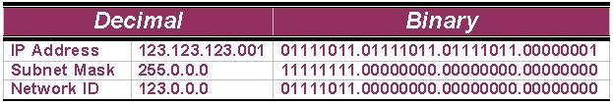
Subnetting Networks ID
A 3-step example of how the default Class A subnet mask is applied to a Class A address:

Slide 7
Subnetting Networks ID (Cont.)
In the previous slide, the default Class A subnet mask (255.0.0.0) is AND’d with the Class A address (123.123.123.001) using Boolean Algebra, which results in the Network ID (123.0.0.0) being revealed.
The default Class B subnet mask (255.255.0.0) strips out the 16-bit network ID & the default Class C subnet mask (255.255.255.0) strips out the 24-bit network ID.

Slide 8
Subnetting, Subnet & Subnet Mask
Subnetting, a subnet & a subnet mask are all different.
In fact, the 1st creates the 2nd & is identified by the 3rd.
Subnetting is the process of dividing a network & its IP addresses into segments, each of which is called a subnetwork or subnet.

Slide 9
Subnetting, Subnet & Subnet Mask (Cont.)
The subnet mask is the 32-bit number that the router uses to cover up the network address to show which bits are being used to identify the subnet.

Slide 10
Subnetting
A network has its own unique address, such as a Class B network with the address 172.20.0.0 which has all zeroes in the host portion of the address.
From the basic definitions of a Class B network & the default Class B subnet mask, you know that this network can be created as a single network that contains 65,534 individual hosts.

Slide 11
Subnetting (Cont.)
Through the use of subnetting, the network from the previous slide can be logically divided into subnets with fewer hosts on each subnetwork.
It does not improve the available shared bandwidth only, but it cuts down on the amount of broadcast traffic generated over the entire network as well.

Slide 12
Subnetting (Cont.)
The 2 primary benefits of subnetting are:
Fewer IP addresses, often as few as one, are needed to provide addressing to a network & subnetting.
Subnetting usually results in smaller routing tables in routers beyond the local internetwork.

Slide 13
Subnetting (Cont.)
Example of subnetting: when the network administrator divides the 172.20.0.0 network into 5 smaller networks – 172.20.1.0, 172.20.2.0, 172.20.3.0, 172.20.4.0 & 172.20.5.0 – the outside world stills sees the network as 172.20.0.0, but the internal routers now break the network addressing into the 5 smaller subnetworks.

Slide 14
Subnetting (Cont.)
In the example, only a single IP address is used to reference the network & instead of 5 network addresses, only one network reference is included in the routing tables of routers on other networks.

Slide 15
Borrowing Bits to Grow a Subnet
The key concept in subnetting is borrowing bits from the host portion of the network to create a subnetwork.
Rules govern this borrowing, ensuring that some bits are left for a Host ID.
The rules require that two bits remain available to use for the Host ID& that all of the subnet bits cannot be all 1s or 0s at the same time.

Slide 16
Borrowing Bits to Grow a Subnet (Cont.)
For each IP address class, only a certain number of bits can be borrowed from the host portion for use in the subnet mask.

Slide 17
Borrowing Bits to Grow a Subnet (Cont.)
Bits Available for Creating Subnets
Address Class
Host Bits
Bits Available for Subnet
A
24
22
B
16
14
C
8
6

Slide 18
Subnetting a Class A Network
The default subnet mask for a class A network is 255.0.0.0 which allows for more than 16,000,000 hosts on a single network.
The default subnet mask uses only 8 bits to identify the network, leaving 24 bits for host addressing .

Slide 19
Subnetting a Class A Network (Cont.)
To subnet a Class A network, you need to borrow a sufficient number of bits from the 24-bit host portion of the mask to allow for the number of subnets you plan to create, now & in the future.
Example: To create 2 subnets with more than 4 millions hosts per subnet, you must borrow 2 bits from the 2nd octet & use 10 masked (value equals one) bits for the subnet mask (11111111.11000000) or 255.192 in decimal.

Slide 20
Subnetting a Class A Network (Cont.)
Keep in mind that each of the 8-bit octets has binary place values.
When you borrow bits from the Host ID portion of the standard mask, you don’t change the value of the bits, only how they are grouped & used.

Slide 21
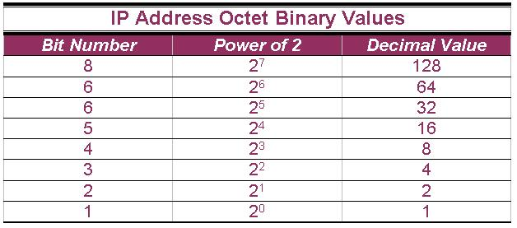
Subnetting a Class A Network (Cont.)

Slide 22
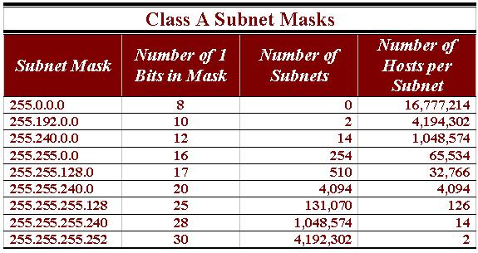
Class A Subnet Masks (Cont.)
A sample of subnet mask options available for Class A addresses.

Slide 23
Class A Subnet Masks (Cont.)
All subnet masks contain 32 bits; no more, no less.
However a subnet mask cannot filter more than 30 bits. This means 2 things:
One, that there cannot be more than 30 ones bits in the subnet mask.
Two, that there must always be at least 2 bits available for the Host ID.

Slide 24
Class A Subnet Masks (Cont.)
The subnet mask with the highest value (255.255.255.252) has a binary representation of:
11111111.11111111.11111111.11111100
The 2 zeroes in this subnet mask represent the 2 positions set aside for the Host address portion of the address.

Slide 25
Class A Subnet Masks (Cont.)
Remember that the addresses with all ones (broadcast address) & all zeroes (local network) cannot be used as they have special meanings.

Slide 26
Subnetting Class B & Class C
The table on slide 76 “Class A Subnet Masks” is similar to the tables used for Class B & Class C IP addresses & subnet masks.
The only differences are that you have fewer options (due to a fewer number of bits available) & that you’re much more likely to work with Class B & Class C networks in real life.

Slide 27
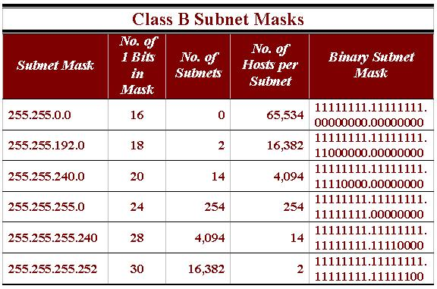
Subnetting Class B & Class C (Cont.)
A sample of the subnet masks available for Class B networks.

Slide 28
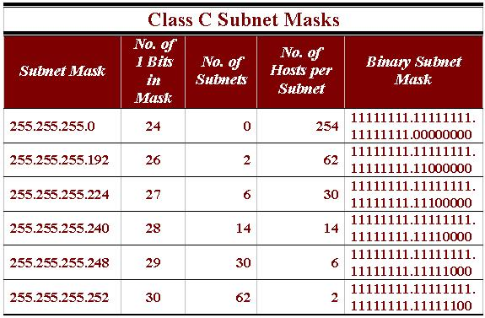
Subnetting Class B & Class C (Cont.)
A list of the subnet masks available for Class C networks.

Slide 29
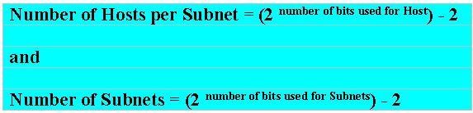
Knowing How to Calculate Subnets
To determine the number of subnets & hosts per subnet available for any of the available subnet masks, 2 simple formulas to calculate these numbers:

Slide 30
Knowing How to Calculate Subnets (Cont.)
Although the 2 formulas look identical, the key is to remember the number you’re trying to calculate, hosts or subnets.
Eg., suppose you are asked to determine the number of subnets available & the number of hosts available on each subnet on the network 192.168.1.0 ➔

Slide 31
Knowing How to Calculate Subnets (Cont.)
Using the subnet & hosts formulas, the answers are easily calculated. Of course, you must know your powers of 2 to calculate the answers.

Slide 32
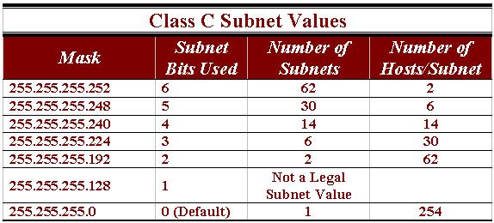
Class C Subnets
Knowing the relationships in this table will significantly reduce the time you spend calculating subnetting problems.

Slide 33
Class C Subnets (Cont.)
To determine the total length of the subnet mask, add 24 to the number of borrowed (subnet) bits.

Slide 34
Class B Subnets
To calculate the number of subnets & hosts available from a Class B subnet mask, you use the same host & subnet formulas described for calculating Class C values.
Using these formulas I have constructed a table that contains the Class B subnet & host values.

Slide 35
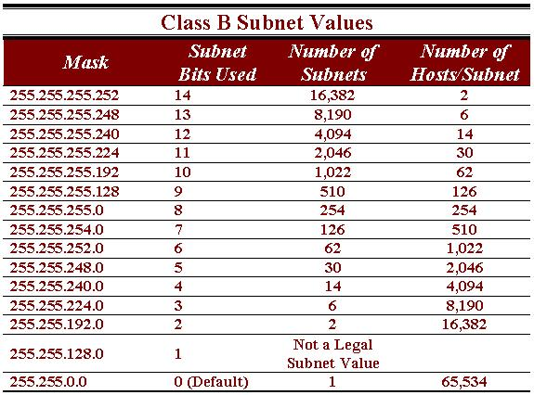
Class B Subnets (Cont.)

Slide 36
A Short Broadcast
A broadcast is a message that every node on a network or subnetwork receives & examines.
Cisco IOS supports 2 different types of broadcast messages:
Flooded
Directed

Slide 37
A Short Broadcast (Cont.)
Generally speaking, routers do not propagate broadcasts, which is one of the benefits of installing a router in the first place.

Slide 38
A Short Broadcast (Cont.)
Flooded broadcasts (those with the nominal broadcast address of 255.255.255.255) are not forwarded by the router & are considered local traffic only.
Directed broadcasts, which contain all 1’s in the Host portion of the IP address, are addressed to a specific subnetwork & are allowed to pass.

